Slide 1
Stage 3: Conducting market research

Slide 2
Introduction
Market research is used by grown-up businesses to help them find out what their customers need and like.
We can use it to find which pizza toppings our pizzeria customers would like to buy when they visit.
Why do we need to know this?

Slide 3
Our question
What question should we ask our customers to help us serve what they like in our pizzeria?

Slide 4
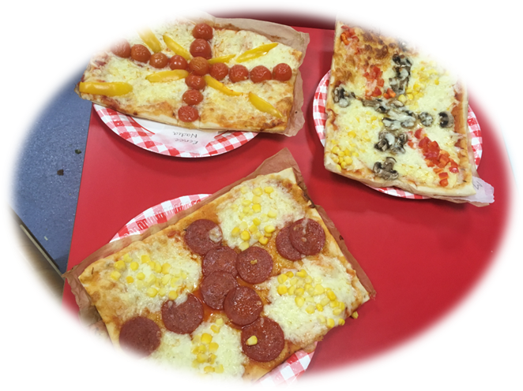
Topping choosing
In your business groups, choose three or four flavours pizza toppings that you would like to ask customers about.

Slide 5
Tally charts
Pizza Topping | Tally
Ham & mushroom
Chicken & red pepper
Beef & red onion
Tomato, rocket & sweetcorn
2. Each time someone votes for a flavour, make a tally mark in the tally column.
For your fifth tally mark, draw your line through your first 4 tally marks.
1. Draw a table with 2 columns. One is for your pizza topping ideas and the other is for how many children voted for them.

Slide 6
Drawing a pictogram
Pizza Topping | Tally
Ham & mushroom
Chicken & red pepper
Beef & red onion
Tomato, rocket & sweetcorn
Key:
=2
2. Draw 1 symbol for every 2 people who voted for each topping.
1. Draw a table with 2 columns. One is for your pizza topping ideas and the other is for how many children voted for them.
3. Add a key.
4. How can we show an odd number of votes?
5. How many children voted for each topping?

Slide 7
Conclusion
Write a sentence to explain what your market research showed.

